Slide 1


Digital Logic and Design

Slide 2


Slides can be found at
https://github.com/sajjo79/Digital-Logic-Design

Slide 3
Introduction to Sequential Circuits
Chapter 4: Sequential circuits

Slide 4
Background
Almost all digital devices, now a days, can send, receive and store information in binary form
Such information processing and storing is based on digital memory
Combinational circuits produce output based on current input with no storage elements
Sequential circuits have combinational logic that also involves storage
Input
Combinational Circuit
Output
Memory

Slide 5
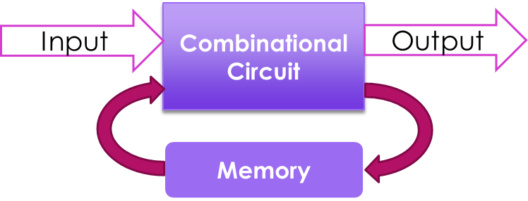
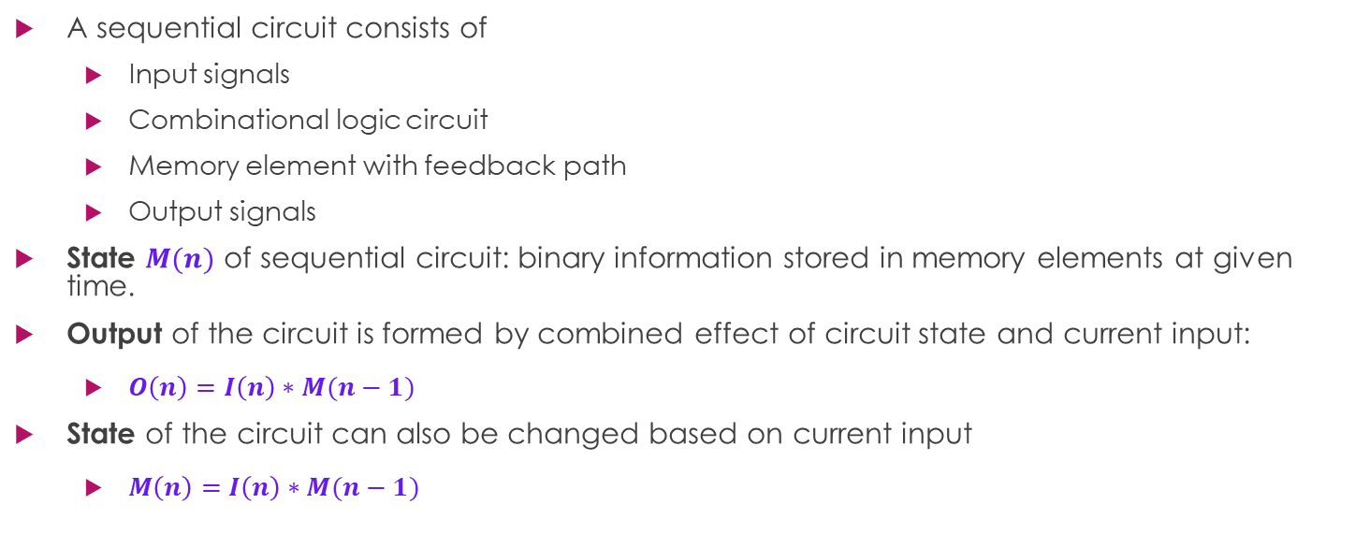
Sequential Logic
A sequential circuit consists of
Input signals
Combinational logic circuit
Memory element with feedback path
Output signals
State $M(n)$ of sequential circuit: binary information stored in memory elements at given time.
Output of the circuit is formed by combined effect of circuit state and current input:
$O\left(n\right)=I\left(n\right)∗M(n−1)$
State of the circuit can also be changed based on current input
$M\left(n\right)=I\left(n\right)∗M(n−1)$
A sequential circuit is specified by a time sequence of inputs, outputs, and internal states

Slide 6
Types of Sequential Circuits
Sequential Logic Circuit
Event Driven Circuits
(Asynchronous)
Clock Driven Circuit
(Synchronous)
Pulse Driven

Slide 7
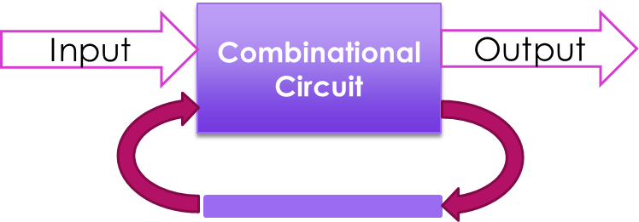
Type of Sequential Circuits
Synchronization: is the precise coordination of multiple signals/events
Synchronous Sequential Circuit: A system whose behavior is defined by its signals at well defined discrete instants of time (input signals, time interval)
Asynchronous Sequential Circuit: A system whose behavior is defined by input signals at any instant of time and the order in which the inputs change (input signals, order of input signals)
For asynchronous sequential circuits storage elements are time-delay devices i.e. devices that delay the signal
Delays incurred due to logic gates is sufficient for signal to flow through time-delay devices hence no extra delay is required to introduce in td-devices
Thus, an asynchronous sequential circuit may be regarded as a combinational circuit with feedback.
Because of the feedback among logic gates, an asynchronous sequential circuit may become unstable at times.
The instability problem imposes many difficulties on circuit the designer.

Slide 8
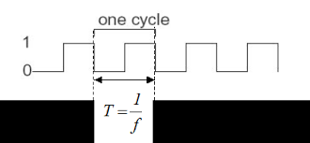

Synchronous Sequential Circuit (SSC)
In these circuits memory elements are effected at discrete instants of time
The Synchronization is achieved by a timing device called a clock generator,
Clock generator provides a clock signal having the form of a periodic train of clock pulses.
The clock signal is commonly denoted by the identifiers clock and clk.
Synchronous sequential circuits that use clock pulses to control storage elements are called clocked sequential circuits
The storage elements are connected with clk and affected only when clk pulse comes.
Input signals to synchronous sequential circuits determines what changes to memory and output be done
Clk signals determine when these changes be done
Example:
Consider an adder that adds two numbers and stores them in memory
Input signals provide what to be added
Clk provides when to be added

Slide 9
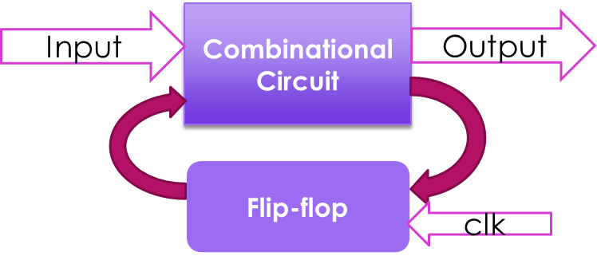

SSC
There are number of goods with SS Circuits that make them attractive to build and use
They seldom present instability
Their timing can be easily controlled using clk circuit
Storage elements used in SSC are called flip-flops
Flipflop: a binary storage device capable of storing one bit of information
Value stored in a flip-flop is either 0 or 1 (in stable state)
To store multiple bits, multiple flip-flops are used
Flip-flop state and output of circuit, both are functions of input and previous state
The speed of circuit is critical. Before next operation, a flip-flop must reach to stable state
Clock speed must be maintained in a way such that before next clock pulse, ff must reach stable state

Slide 10
SSC
ff only initiates its operation when a clock pulse arrives,
Input
Combinational Circuit
Output
Flip-flop
clk

Slide 11
11
Thanks for watching
Dr. Sajid Iqbal
Assistant Professor
Department of Computer Science
Bahauddin Zakariya University, Multan
Allah Hafiz
Slides are available at: https://github.com/sajjo79/Digital-Logic-Design

Slide 13
Input
Combinational Circuit
Output
Flip-flop
clk

